Slide 1
Molding
1st General Meeting
September 17, 2013
CN 1.120 7:00 PM

Slide 2
Molding
Advisor: Dr. de Olivares, Director of UTD HPAC
President: Horacio Martinez
Vice President: Linh Trieu
Secretary: Haris Vakil
Treasurer: Nicolette Doan
Webmaster/Event Outreach: Lina Moon
Notes:
We’ll start with introducing the officers, Lina will begin and then Nicolette and so on. Basic description of who you are, what year, major, current position in medical school process (preparing/taken the MCAT, applying next cycle? Etc) and if you want to add why you want to be a physician

Slide 3
Molding
What is Molding Doctors?
A close-knit organization that centers on the internal aspects that must be fulfilled as a pre-medical student.
An organization that focuses on exposing you to a healthcare setting.
An atmosphere where we provide experience and resources to better prepare you and make you a more competitive medical school applicant .
Notes:
-Horacio

Slide 4
Molding
Membership Requirements
10$ per semester or 15$ for the whole year
Dues are required for membership and entrance
to our events
Dues due by 3rd General Meeting in Nov
Point-based System
-Coming to our general meetings
-Participation during meetings
-Going to MD events
-Etc
Notes:
-Nicolette: Mention that their dues come back to them in the form of scrubs, food, opening of events, etc.
-Haris: Will talk about the point based system, he will be taking points during the meeting; members will be able to see their points on the website and their rank; for the top 3 members at the end of the year, maybe we’ll provide a little something for their well efforts.

Slide 5
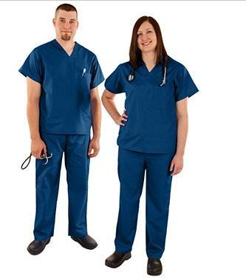
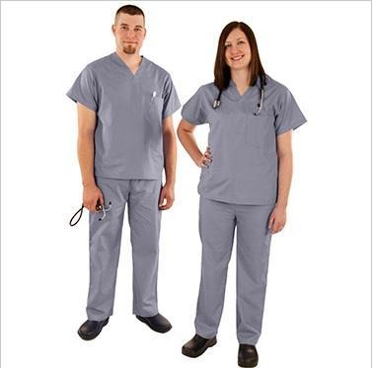
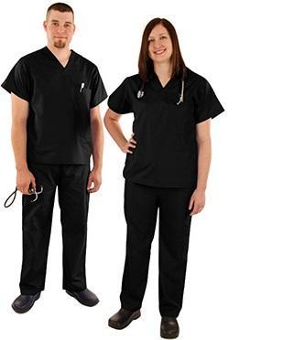
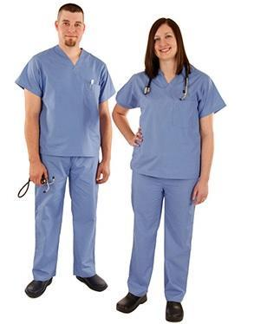
Molding
$10 – Members
$15 – Non-Members
Scrubs
Navy Blue Gray Black Pale Blue
Notes:
Nicolette: poll will be taken next meeting; talk how they are very cheap, need them to volunteer at hospitals or other events

Slide 6
Molding
Services
and
Upcoming Events

Slide 7
Molding
Vietnamese Health Fairs
VAMA Health Fair: Sunday 9/22/13
-9am – 1pm
-Address is VAMAS, 2300 W Walnut St, Garland TX 75042
-4 volunteers needed
VAMA Health Fair: Saturday 10/05/13
-10am – 2pm
-Address: Hong Kong Super Market 9780 Walnut St, Dallas, TX 75243
-Working with Dallas Police Department
-10 volunteers needed
-Carpooling*
Notes:
Horacio
1st VHF: only 4 volunteers required (reason: we started a little bit late and they started early, most spots were filled)
2nd VHF: 10 volunteers required
-You are there to volunteer
-Talk in the past what volunteers did (set up the event) (take BMI, blood pressure, check for cholesterol and diabetes)
-First come first serve basis
-You guys have fist dibs for coming to the meeting, register at end of meeting if more volunteers needed, send email registration ,

Slide 8
Molding
National Kidney Foundation
Cornerstone Health Fair: Saturday 09/21/131
-9:30am – 2:00pm -Address: Cornerstone Baptist Church, 1819 Martin Luther King Jr. Blvd, Dallas, Texas 75215
-10 volunteers needed.
-Responsibilities: Registration, blood pressure checks and BMI Checks. -Attire can be scrubs, but jeans are fine.
-Provide t-shirts for the volunteers.
Notes:
Horacio

Slide 9
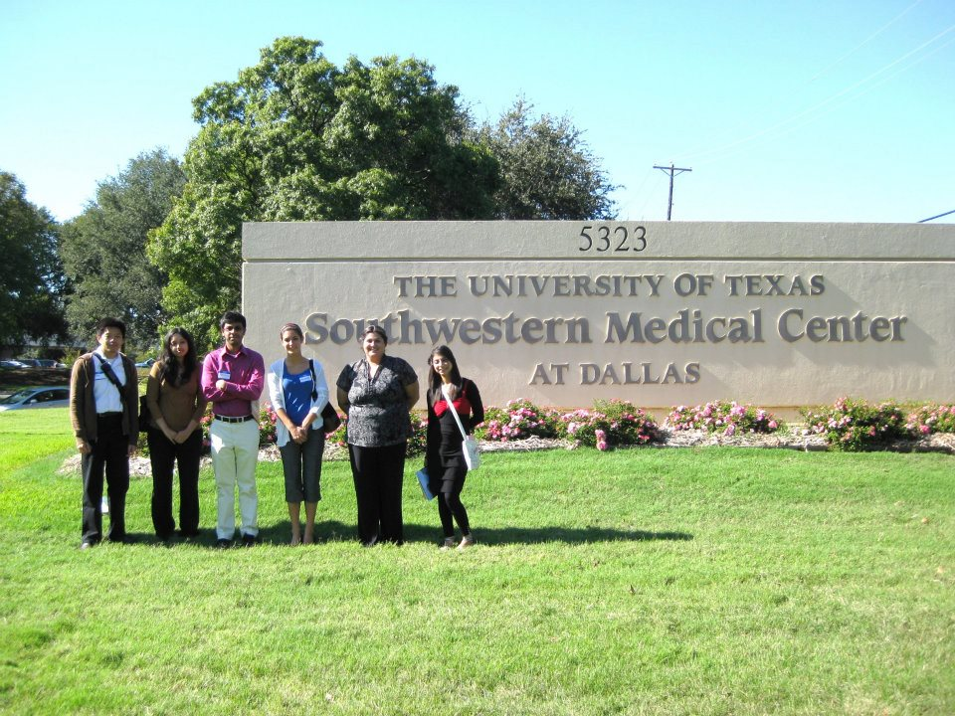
Molding
UTSW Pre-Medical Conference
Saturday November 16, 2013 from 8:00am-3:30pm
A “must” attend conference, especially for freshman and
sophomores.
Great experience, meet doctors and medical students
Notes:
Linh: talk about the conference, what they do and what they discuss (medical school requirements, MCAT, UTSW events, financial aid information)
You also distribute into groups with actual UTSW medical students and you can ask them whatever you want

Slide 10
Molding
Upcoming
Guest Speakers

Slide 11
Molding
Dr. Jones,
Assistant Dean of Admissions at UTSA
Thursday September 26th at 7:00 PM
CN 1.120
Dr. Jones Fireside Chat, bring
your questions and come get
to know him!
Notes:
Haris

Slide 12
Molding
Planned on coming to our 2rd General Meeting
Tuesday October 1st at 7:00 PM Room: CN 1.120
Visiting us on our 3rd General Meeting
Tuesday November 5th at 7:00 PM Room: TBA
Notes:
Linh: Quick explanation of what these programs are, what they do, etc
Even though Princeton hasn’t confirmed yet, they most likely will, they never miss a chance to come and talk

Slide 13
Molding
Discussion
Topics
Notes:
Horacio: why we do this? Good way to get points includes: current event, mcat questions, interview questions, and ethics cases

Slide 14
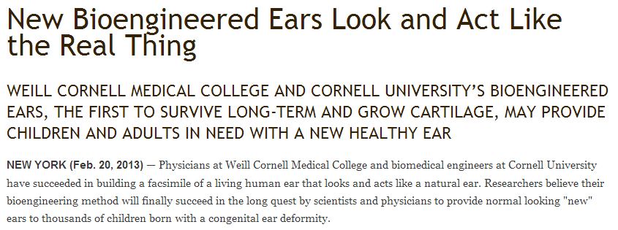
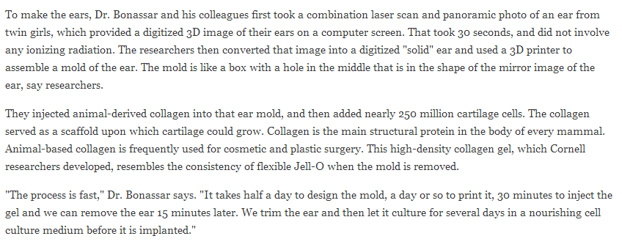
Molding
Current
Event
Notes:
Lina: Discuss the current event and what’s the important information to take home; mention that as pre-meds, we should always be updated and be aware of what’s going on, especially in the medical field
Who would it help?
People that have lost ears due to accidents
People hat have lost ears due to cancer
Children born with deformed ear (microtia); have inner ear, but hearing loss because no outer ear
How has this been done in the past?
Ears made using materials that have a Styrofoam-like consistency
Ears made using rib harvested from young patient – but very painful, ear doesn’t look good/perform well
Other attempts to grow ears in lab (ears on back of mice) have failed in long term
Other ears couldn’t maintain shape or form, cells didn’t survive
How does it work?
Takes a week to manufacture
Used specifically to replace body parts made of cartilage, because cartilage apparently doesn’t need a blood supply in order to survive
Laser scan & panorama of ear → 3D image, took 30 seconds without radiation
Used 3D printer to make a mold
Added animal-derived collagen into the mold (on which cartilage could grow, often used for plastic surgery, specially developed by Cornell)+ 250 million cartilage cells
When mold is removed, ear feels like jello
Ear is trimmed, and then left to culture for a few days in a cell medium before implanted
Eventually cartilage grows to replace collagen and only has cartilage, just like a real ear
Surgery to attach new ear would be easy, but would the new ear grow to full size? (if implanted in a 5-6 year old child)
Could try first human implant in 3 years after safety tests
What are some applications?
Also working on bioengineered disc replacements using same technique
http://weill.cornell.edu/news/releases/wcmc/wcmc_2013/02_20_13-2.shtml

Slide 15
Molding
Interview Questions
What hesitations or reservations do you have about joining the medical profession?
There are 1,000 applicants as qualified as you, why should we select you for our class?
Notes:
Haris: Depending on the time, aim for 5-6 minutes
Don’t want to pick on people, but if we must, we must; there’s no wrong answer as long as you support it, be yourself

Slide 16
Molding
Ethics Case
A woman enters the emergency room with stomach pain. She undergoes a CT scan and is diagnosed with an abdominal aortic aneurysm, a weakening in the wall of the aorta which causes it to stretch and bulge (this is very similar to what led to John Ritter's death). The physicians inform her that the only way to fix the problem is surgically, and that the chances of survival are about 50/50. They also inform her that time is of the essence, and that should the aneurysm burst, she would be dead in a few short minutes. The woman is an erotic dancer; she worries that the surgery will leave a scar that will negatively affect her work; therefore, she refuses any surgical treatment. Even after much pressuring from the physicians, she adamantly refuses surgery. Feeling that the woman is not in her correct state of mind and knowing that time is of the essence, the surgeons decide to perform the procedure without consent. They anesthetize her and surgically repair the aneurysm. She survives, and sues the hospital for millions of dollars.
Notes:
Linh: we may not have time for the ethics case, depending on time, but just in case
Questions for Case 1:
Do you believe that the physician's actions can be justified in any way?
Is there anything else that they could have done?
Is it ever right to take away someone's autonomy? (Would a court order make the physicians' decisions ethical?)
What would you do if you were one of the health care workers?

Slide 17
Molding
Next Meeting:
2nd General Meeting
Tuesday October 1st
7:00 PM @ CN 1.120
Notes:
Lina

Slide 18
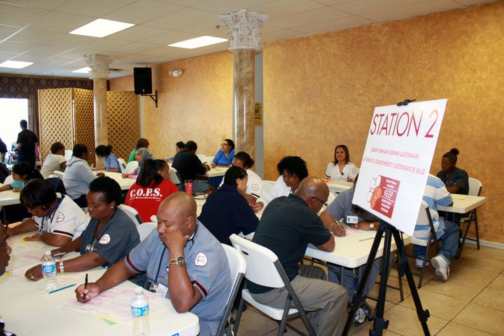
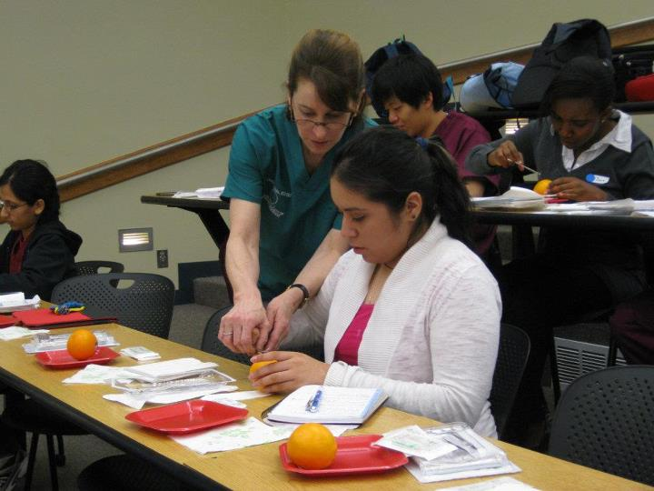
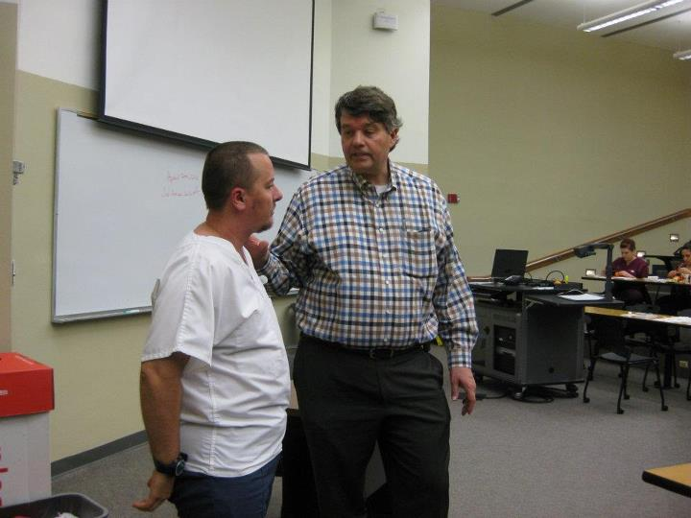
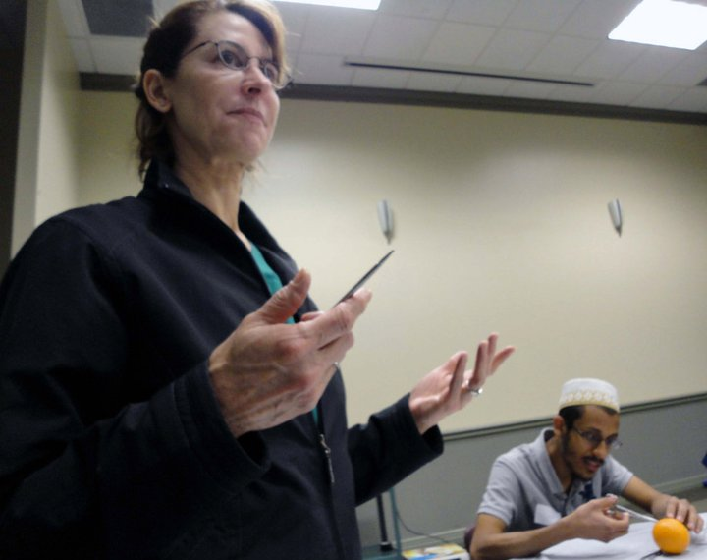
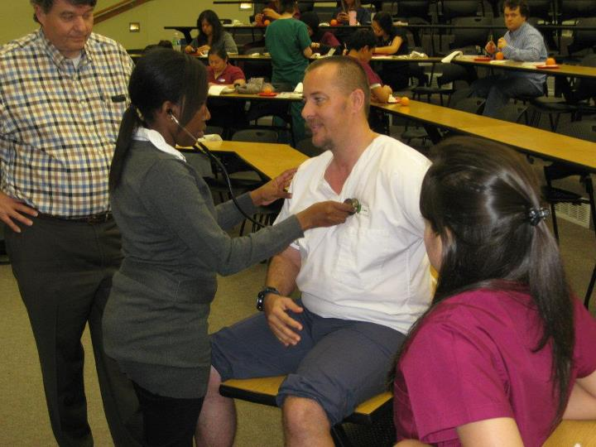
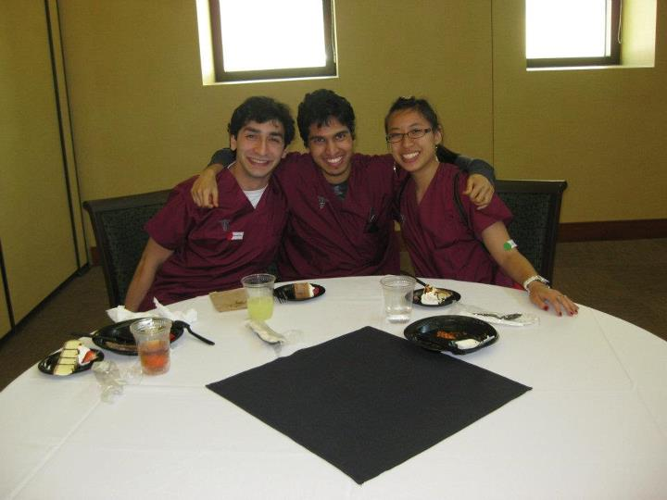
Molding
Website: http://moldingdoctors.weebly.com/
Email: MoldingDoctors@gmail.com

