Slide 1
Molding
2nd General Meeting
October 1st, 2013
CN 1.120 7:00 PM

Slide 2
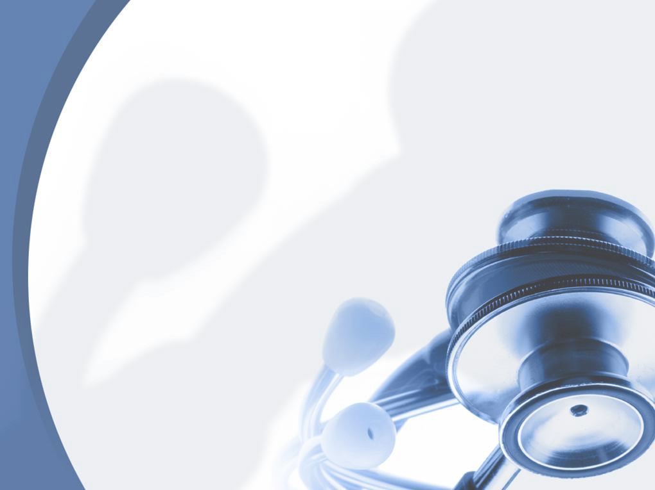
Molding
Advisor: Dr. de Olivares, Director of UTD HPAC
President: Horacio Martinez
Vice President: Linh Trieu
Secretary: Haris Vakil
Treasurer: Nicolette Doan
Webmaster/Event Outreach: Lina Moon

Slide 3
Molding
What is Molding Doctors?
A close-knit organization that centers on the internal aspects that must be fulfilled as a pre-medical student.
An organization that focuses on exposing you to a healthcare setting.
An atmosphere where we provide experience and resources to better prepare you and make you a more competitive medical school applicant .

Slide 4
Molding
Membership Requirements
10$ per semester or 15$ for the whole year
Dues are required for membership and entrance
to our events
Dues due by 3rd General Meeting in Nov
Point-based System
-Coming to our general meetings
-Participation during meetings
-Going to MD events
-Etc

Slide 5
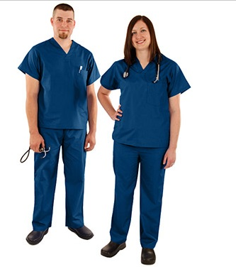
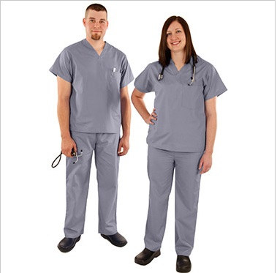
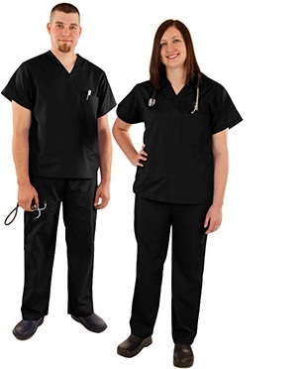
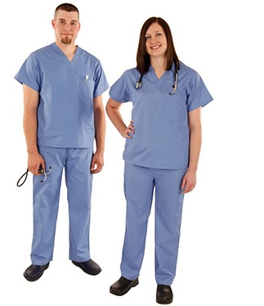
Molding
$10 – Members
$15 – Non-Members
Scrubs
Navy Blue Gray Black Pale Blue

Slide 6
Molding
Services
and
Upcoming Events

Slide 7
Molding
Vietnamese Health Fairs
VAMA Health Fair: Sunday 9/22/13
-9am – 1pm
-Address is VAMAS, 2300 W Walnut St, Garland TX 75042
-5 volunteers needed
VAMA Health Fair: Saturday 10/05/13
-10am – 2pm
-Address: Hong Kong Super Market 9780 Walnut St, Dallas, TX 75243
-Working with Dallas Police Department
-10 volunteers needed
-Carpooling*
Feedback
Filled

Slide 8
Molding
National Kidney Foundation
Cornerstone Health Fair: Saturday 09/21/131
-9:30am – 2:00pm -Address: Cornerstone Baptist Church, 1819 Martin Luther King Jr. Blvd, Dallas, Texas 75215
-5 volunteers needed.
-Responsibilities: Registration, blood pressure checks and BMI Checks. -Attire can be scrubs, but jeans are fine.
-Provide t-shirts for the volunteers.
Feedback

Slide 9
Molding
National Kidney Foundation
October 24th Faith and Community Health Summit, Dallas
October 26th Keep Healthy, Oak Cliff

Slide 10
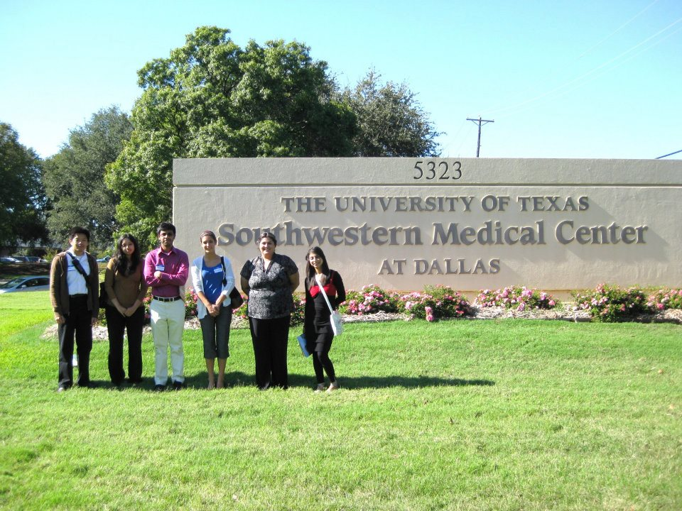
Molding
UTSW Pre-Medical Conference
Saturday November 16, 2013 from 8:00am-3:30pm
A “must” attend conference, especially for freshman and
sophomores.
Great experience, meet doctors and medical students

Slide 11
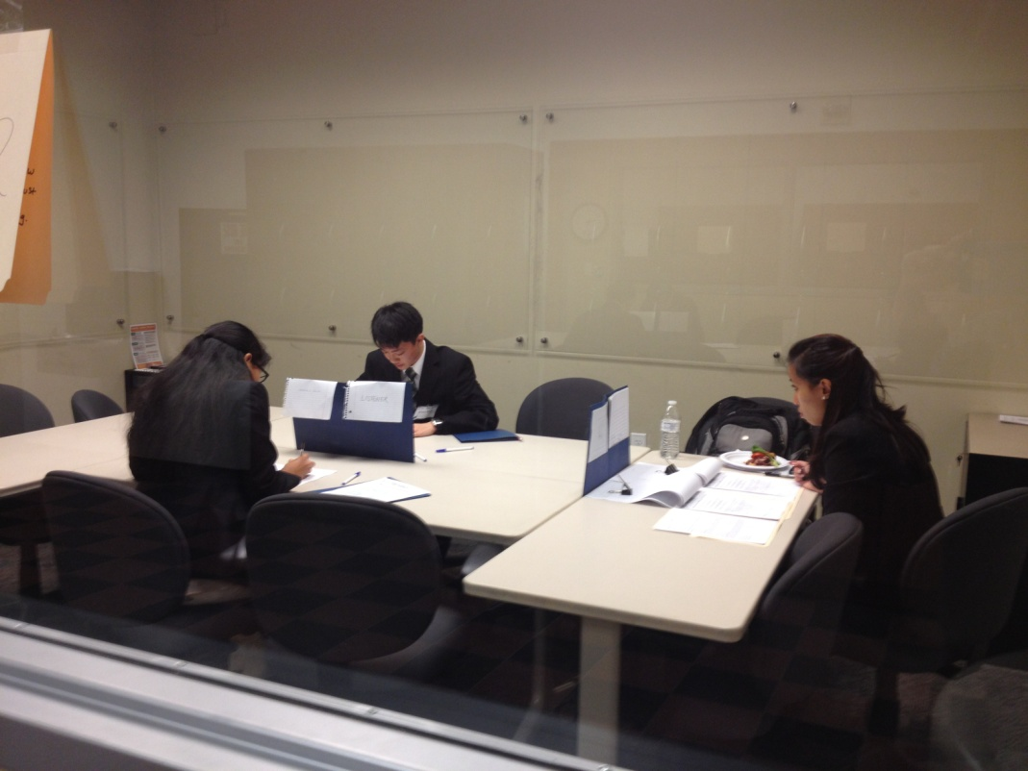
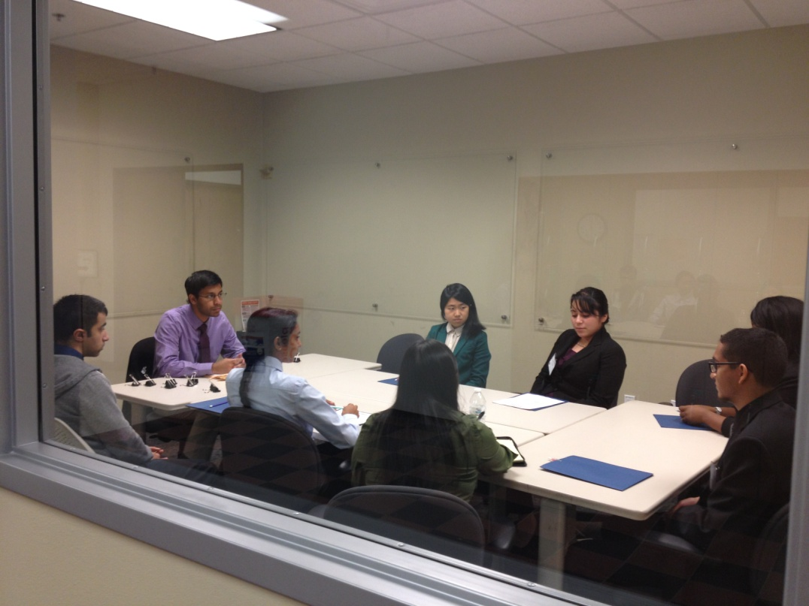
Molding
Big Events:
SANIC
Simulated And Normalized Interview Center

Slide 12
Molding
Discussion
Topics

Slide 13
Molding
Current
Event
Many people who need lung transplants can’t get them, due to a shortage of donor organs. Often because of complications that make lungs unsuitable for transplantation, these organs are only harvested from 15% of deceased donors.
A new “lung washing” technology—ex vivo lung perfusion—can reverse injuries in donor organs by treating them with proprietary fluids and, if needed, medications to clear infections.
Experts estimate that up to 40% of lungs currently rejected for transplant could be repaired with this technology, which is already approved in Europe and Canada.
http://www.clevelandclinic.org/INNOVATIONS/SUMMIT/topten/2013/seven.html#.UknCd4ash8E
Notes:
People with lungs permanently damaged, such as by chronic obstructive pulmonary disease, cystic fibrosis, pulmonary hypertension
In the US, more than 1,800 lung transplants out of a pool of 100,000 potential candidates are expected to be completed annually
Lungs are harvested from only 15% of donors because of complications before/after donor deaths such as pneumonia, thoracic trauma, lung injury to due ventilator, pulmonary edema
What is the process?
Damaged lungs are removed from a donor and placed in a bubble-ish transparent chamber, connected to a cardiopulmonary pump and ventilator
Lungs are repaired and assessed over 4 to 6 hours
Special fluids and nutrients are forced through the blood vessels to renourish the lungs, as well as oxygen; sometimes they are medicated to clear infections
When lungs are cleaned and suitable, ready for immediate transplantation
What is happening now?
- Undergoing major multicenter clinical trial in the US

Slide 14
Molding
Interview Questions
What are three things you want to change about yourself?
2) If you couldn't ever be trained to be a physician, what would you be?

Slide 15
Molding
Ethics Case A woman was diagnosed with motor neurone disease (the same disease that StephenHawking has) 5 years ago. This is a condition that destroys motor nerves, making control of movement impossible, while the mind is virtually unaffected. People with motor neurone disease normally die within 4 years of diagnosis from suffocation due to the inability of the inspiratory muscles to contract. The woman's condition has steadily declined. She is not expected to live through the month, and is worried about the pain that she will face in her final hours. She asks her doctor to give her diamorphine for pain if she begins to suffocate or choke. This will lessen her pain, but it will also hasten her death. About a week later, she falls very ill, and is having trouble breathing.
1.Does she have a right to make this choice?
2. What would you do? If you would pass her off to another doctor knowing he or she would do it, does this free you from you ethical obligations?
3. Is the short amount of time she has to live ethically relevant? Is there an ethical difference between her dying in 6 hours and dying in a week? What about a year, and how do you draw this distinction?
4. Should the money used to care for this woman be taken into account when she is being helped? Do you think that legalizing euthanasia could create conflicts of interest for the patient/ or the doctor?

Slide 16
Molding
They are here!

Slide 17
Molding
Visiting us on our 3rd General Meeting
Tuesday November 5th at 7:00 PM Room: TBA

Slide 18
Molding
Next Meeting:
3nd General Meeting
Tuesday November 5th
7:00 PM @ TBA

Slide 19
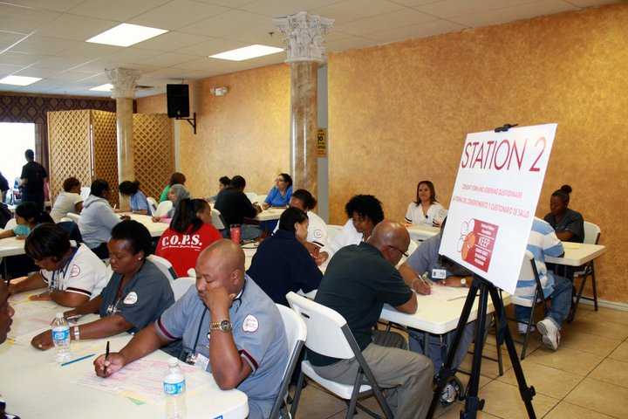
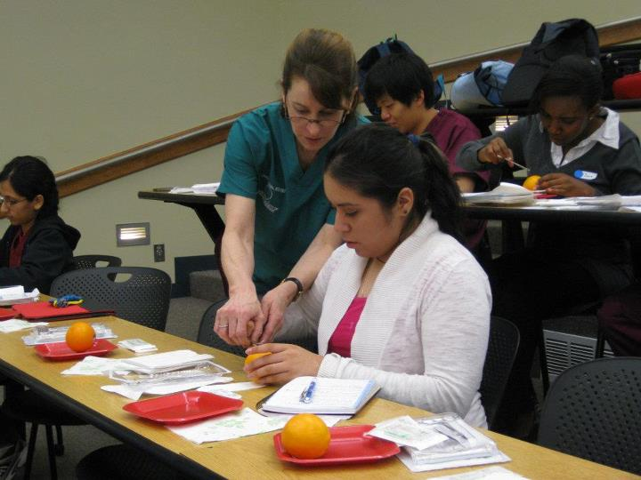
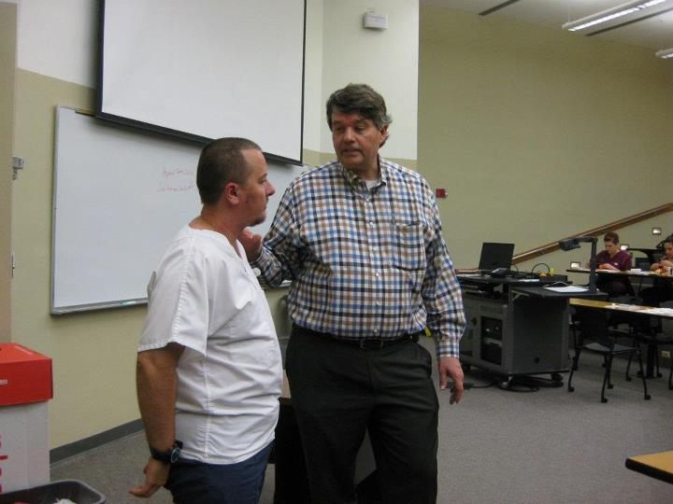
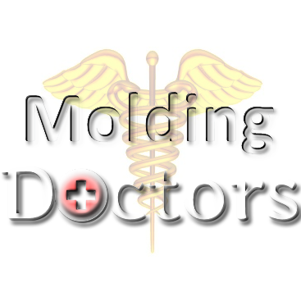
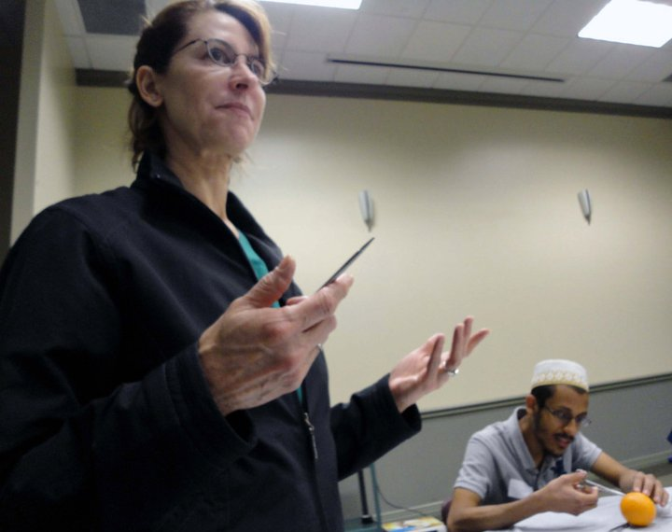
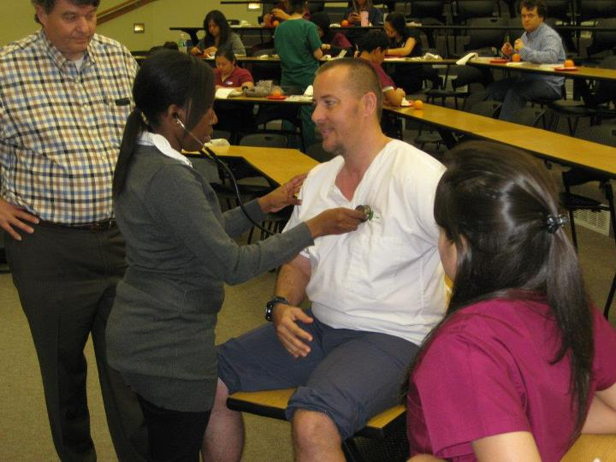
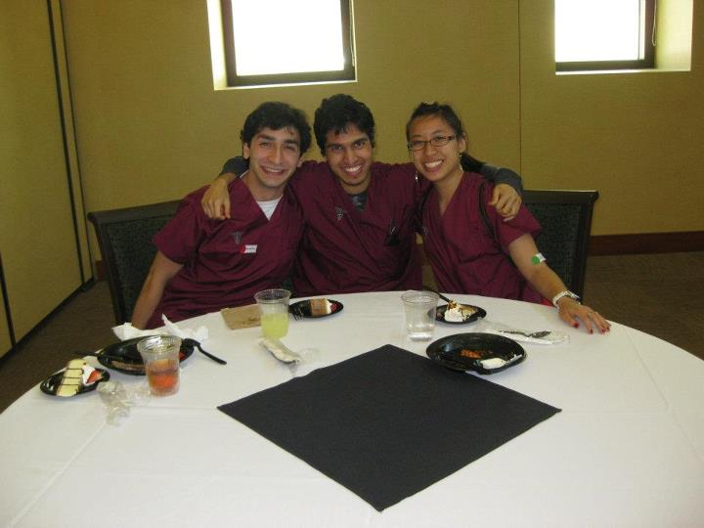
Molding
Website: http://moldingdoctors.weebly.com/
Email: MoldingDoctors@gmail.com

