Slide 1
Molding
3rd General Meeting
November 5th, 2013
CN 1.120 8:00 PM

Slide 2
Molding
Membership Requirements – Due Today!
10$ per semester or 15$ for the whole year
Dues are required for membership, entrance
to our events, and scrubs!
Dues due THIS 3rd General Meeting, especially for those ordering scrubs
Notes:
Nicolette: of course, we’ll have people who wont be able to pay, they really aren’t due this meeting, but we’re pushing it so we can start ordering scrubs, we’ll give it one week to start finalizing scrub orders and start ordering them

Slide 3
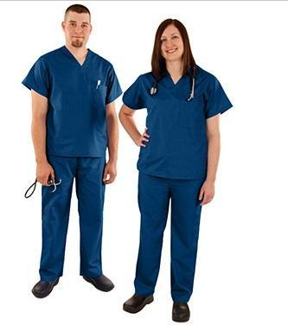
Molding
THE SCRUBS
FOR THIS YEAR ARE….
$10 – Members
$15 – Non-Members
Notes:
Nicolette:

Slide 4
Molding
Ongoing Volunteer Opportunities
The Monday Clinic:
Where to register? www.themondayclinic.com
Monday Clinic Manager: Anna.Rosenblatt@UTSouthwestern.edu
When/Time: Monday’s ~4:30pm-8pm
Responsibilities: Patient Liaison/ Intake-Discharge/Translators
2. NDSM Clinics (North Dallas Shared Ministries)
Who to contact? Rob Smith - rjsmith@mail.smu.edu
When: Tuesdays/Thursdays 5pm-8:30pm
Responsibilities: Database entry/Translators/Admissions/Discharge
3. Other NDSM Clinics
Day-time Medical/Dental Clinic volunteering
Responsibilities: Greet clients, gather in-take data, enter records into computer
Who to contact? Nancy Volk - clinicaldirector@ndsm.org
http://www.ndsm.org/index.php/how-you-can-help/volunteer
Notes:
Horacio: go check their website out first, then contact if have any more question, they are very serious and have a cancellation policy
Make sure you copy this information or you can come ask or email us for the information, wont be sent on general meeting pw
How would you contact them? Hello my name is so and so, I heard of the possible volunteer opportunities at this clinic, I am interested, how can I get started.

Slide 5
Molding
Services
Guest Speakers
and
Upcoming Events

Slide 6
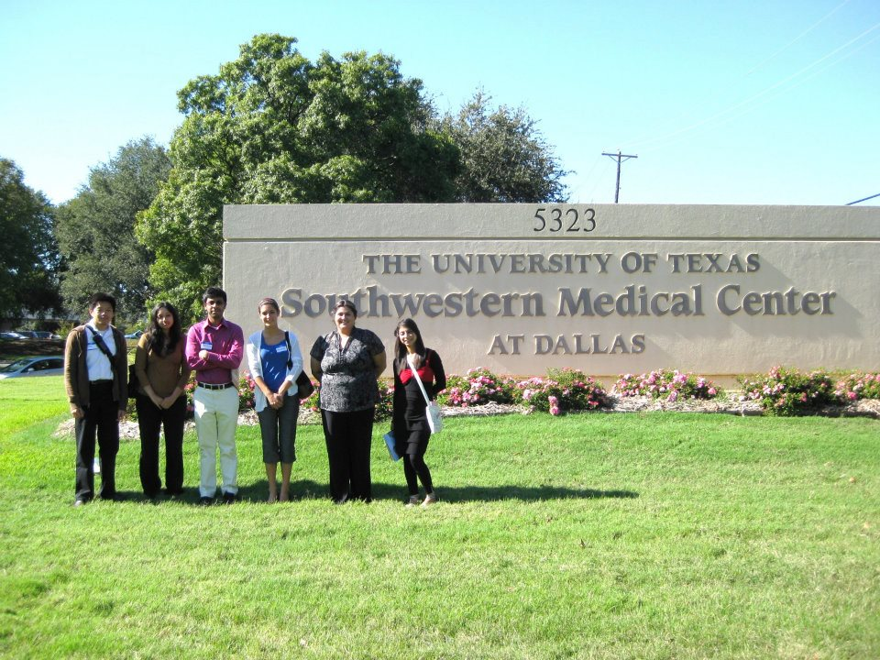
Molding
UTSW Pre-Medical Conference
Next Saturday November 16, 2013 from 8:00am-3:30pm
Registration deadline with UTSW has been extended!
A “must” attend conference, especially for freshman and
sophomores.
Notes:
Linh: Next Saturday! Talk about registration (the one for us and one with UTSW); UTSW registration has been extended so not too late to register; Talk about transportation and rides; as for getting your points, each one of you will get a white folder with your name on it, take a picture of that or show it to us and we’ll add your points!

Slide 7
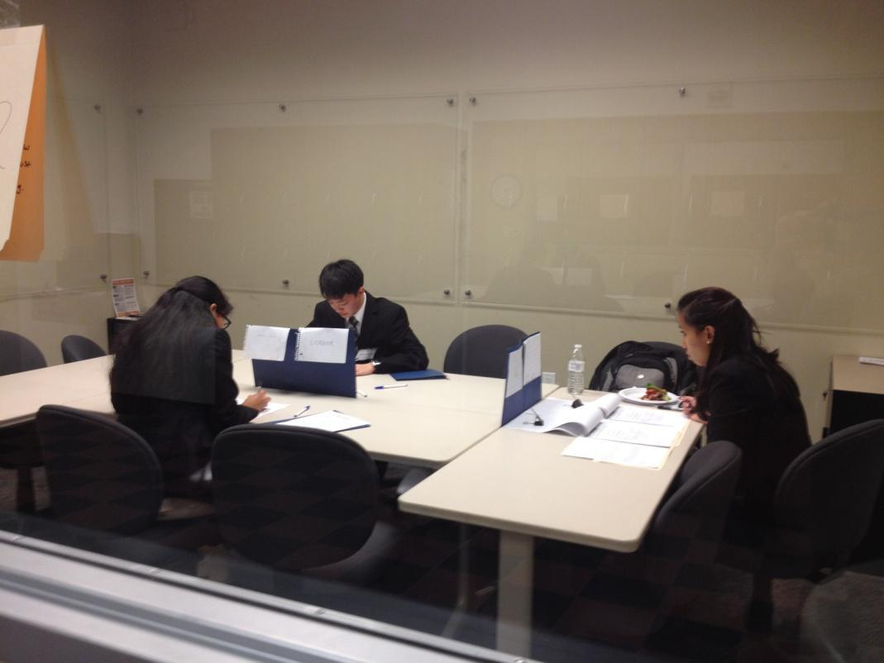
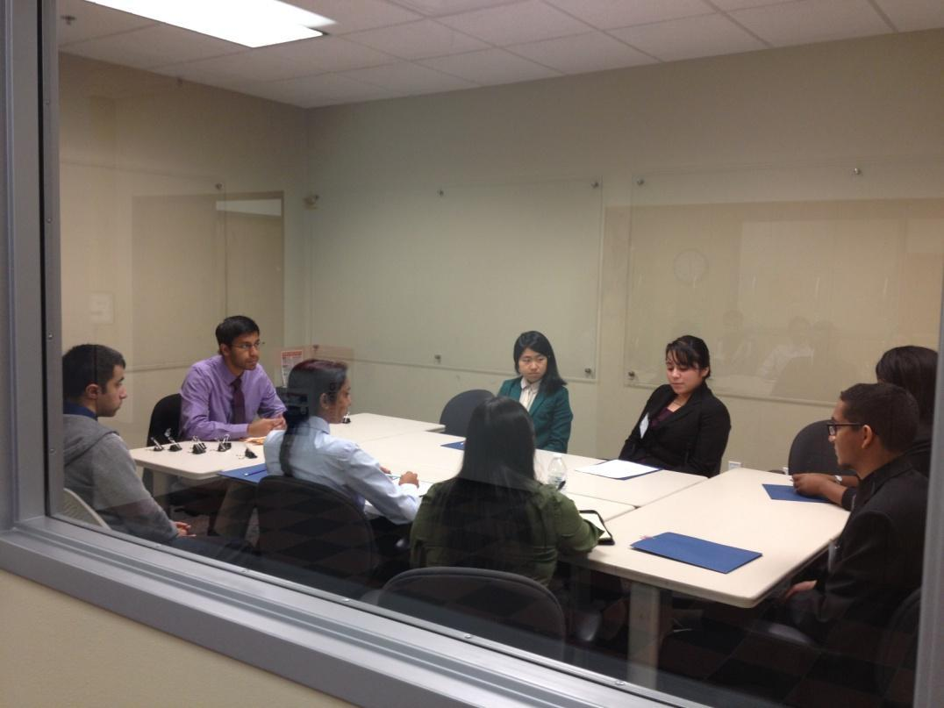
Molding
Big Events: ~March 2013
SANIC
Simulated And Normalized Interview Center
Notes:
Horacio

Slide 8
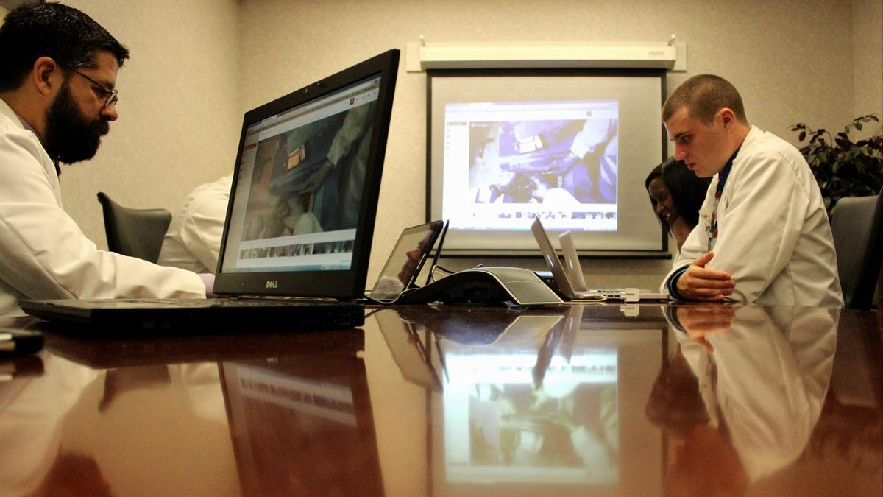
Molding
Streaming OR
Texas Institute Surgery (TIS) is providing an opportunity to allow undergraduate students to view and stream a real live surgery case with Dr. Scheinberg
We’ll all sit in a room with a group of students who can directly ask surgeons any questions while the surgery is taking place.
Great experience that
that most may never get to see till they get
to medical school and
we’ll offer it again!
Notes:
Horacio

Slide 9
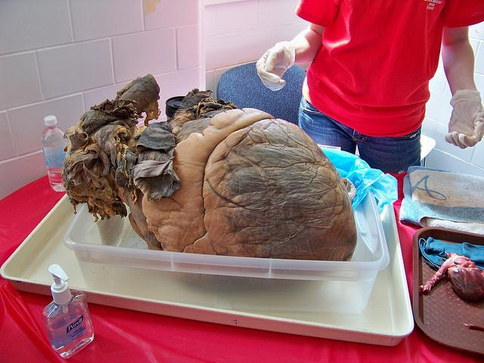
Molding
Dr. Richardson,
Professor at UTSW (Studies include:
Veterinary Medicine, Plastic Surgery, and
Pathology.
Tuesday November 12th at 7:00 PM
GR 2.530
Dr. Richardson is know
for his pathology lectures!
Notes:
Haris: He’s going to come and talk about medical school life and classes at UTSW, some of its structure and of course admissions, but mainly giving his famous pathology lectures, he’s brought an elephants heart to one of his lectures, will he bring it? who knows! Come, bring your friends and bring questions!

Slide 10
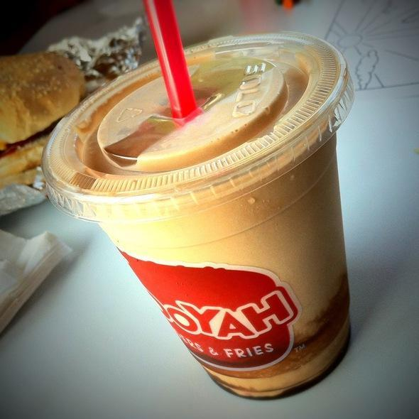
Molding
MD’s Fundraiser/Social
This Thursday Nov 7th
^{11am-9pm: Fundraiser!} ^{6pm-9pm: Come talk} ^{to the officers!}
Notes:
Nicolette: advertise this to the members as much as possible (there are veggie/turkey burgers too) the more people come the more we can fundraise, bring everyone you know! If you come, you get one point, the more people you bring, the more points you get (either take a picture at mooyah’s or a picture of your receipt and email it to us to get your points)!

Slide 11
Molding
Discussion
Topics

Slide 12
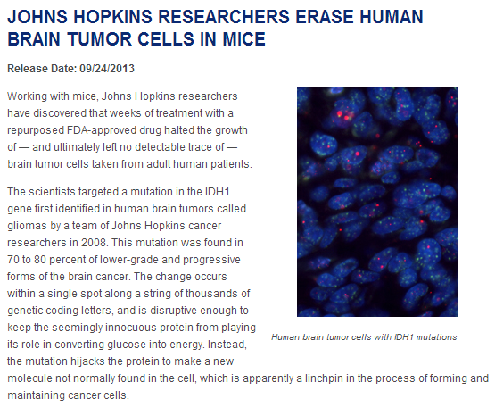

Slide 13
Molding
Interview Questions
1) Where do you see yourself in 5-10 years? 2) What do you think you will like least about medicine?
Notes:
Haris: Depending on the time, aim for 5-6 minutes
Don’t want to pick on people, but if we must, we must; there’s no wrong answer as long as you support it, be yourself

Slide 14
Molding
Ethics CaseA woman was diagnosed with motor neurone disease (the same disease that StephenHawking has) 5 years ago. This is a condition that destroys motor nerves, making control of movement impossible, while the mind is virtually unaffected. People with motor neurone disease normally die within 4 years of diagnosis from suffocation due to the inability of the inspiratory muscles to contract. The woman's condition has steadily declined. She is not expected to live through the month, and is worried about the pain that she will face in her final hours. She asks her doctor to give her diamorphine for pain if she begins to suffocate or choke. This will lessen her pain, but it will also hasten her death. About a week later, she falls very ill, and is having trouble breathing.
1.Does she have a right to make this choice?
2. What would you do? If you would pass her off to another doctor knowing he or she would do it, does this free you from you ethical obligations?
3. Is the short amount of time she has to live ethically relevant? Is there an ethical difference between her dying in 6 hours and dying in a week? What about a year, and how do you draw this distinction?
4. Should the money used to care for this woman be taken into account when she is being helped? Do you think that legalizing euthanasia could create conflicts of interest for the patient/ or the doctor?
Notes:
Linh

Slide 15
Molding
Summer Programs and Research
Opportunities with…
Aaron Dotson!
Notes:
8:30

Slide 16
Molding
Visiting us on Spring Semester!

Slide 17
Molding
Next Meeting:
4th General Meeting
Tuesday December 3rd
7:00 PM @ CN 1.120
Notes:
Lina

Slide 18
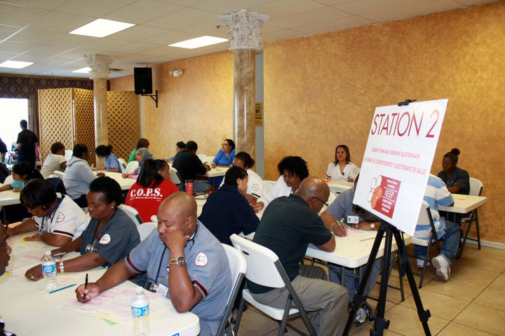
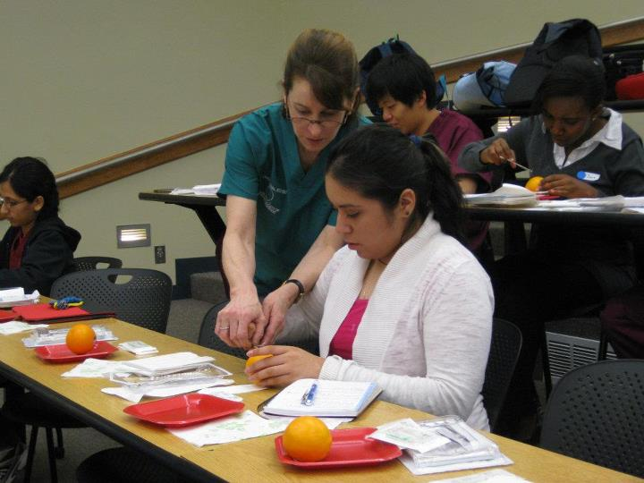
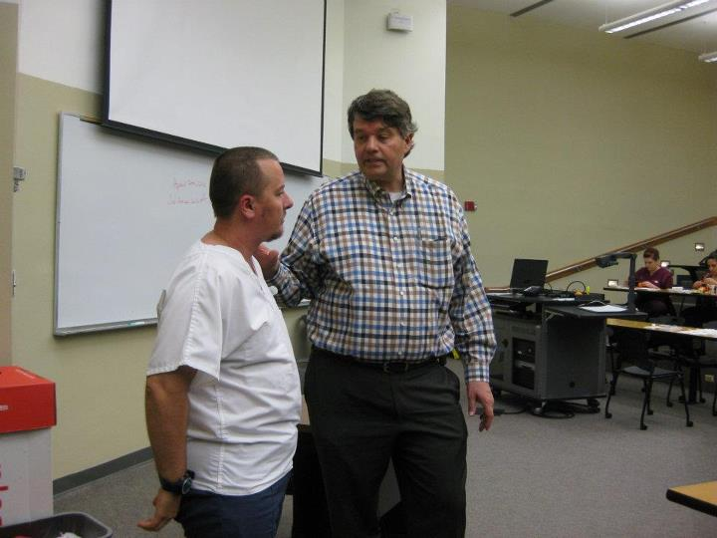
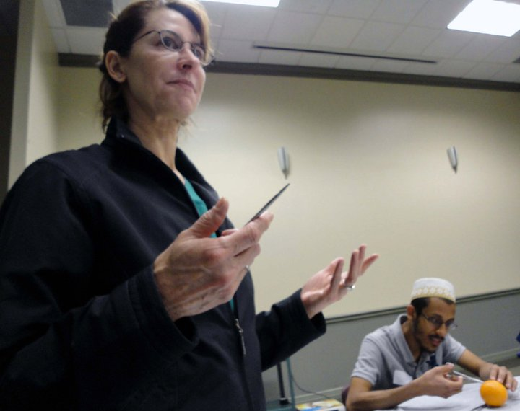
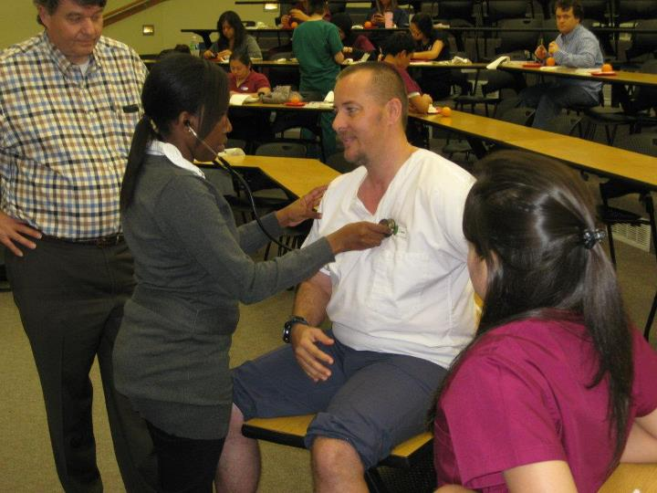
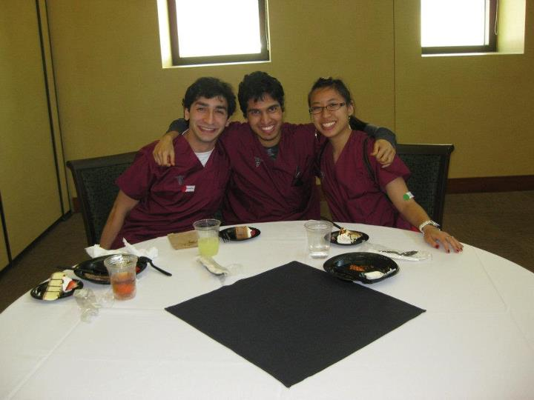
Molding
Website: http://moldingdoctors.weebly.com/
Email: MoldingDoctors@gmail.com

